Slide 1


US AIRLINE SATISFICATION SURVEY REPORT
ALY 6040
Final Presentation
Present By Group 5:
Wanlu Yao, Yi Yang

Slide 2


INTRODUCTION
Business Problem: The satisfaction level of our passengers is not very high
Business Goal: Explore ways to increase US Airline passengers’ satisfaction level
Notes:
It is extremely meaningful to explore what factors that affect US passengers’ satisfaction and try to provide some insights to maintain our loyal customers and attract more customers.

Slide 3
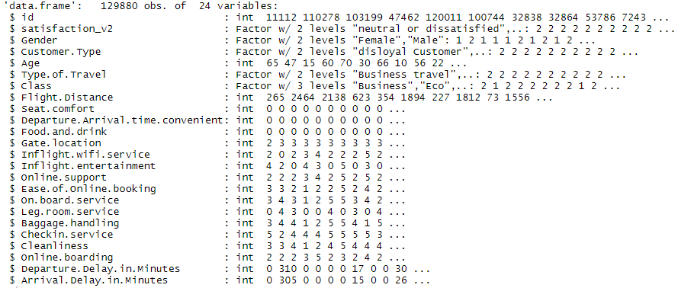

DATA COLLECTION
Collected from US Airline passenger satisfaction survey
Total 129,880 observations
5 Factorial attributes
19 Numeric attributes
Dependent variable: satisfaction_v2(satisfied and neutral or dissatisfied)
Notes:
The dataset contains almost 130, 000 observations, and 24 variables.
From the right graph, we can see most of the attributes are numeric and only 5 of them are factorial.
The key variable that we focused on is called satisfaction_v2 which has 2 levels: neutral or dissatisfied, and satisfied.

Slide 4
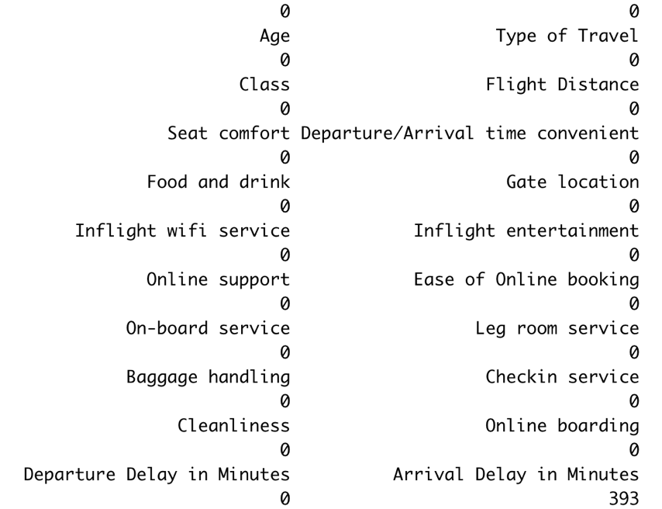
DATA preprocessing
Drop the id column
Sapply() ->393 NAs in Arrival Delay in Minutes
393 /129880 = 0.00302587 = 0.03%-> Exclude
After cleansing: 129,487 records and 23 attributes
Notes:
After knowing the structure of the dataset, we did some cleanup work before diving into future analysis.
First, we dropped the id column since it only served as a counting symbol and was not quite related to our modeling
Second, we observed 393 NAs in Arrival Delay in Minutes. Since the missing value falls between the range of 0-0.5% , so we can conclude that this percentage of NAs does not affect our analysis and can be removed.

Slide 5
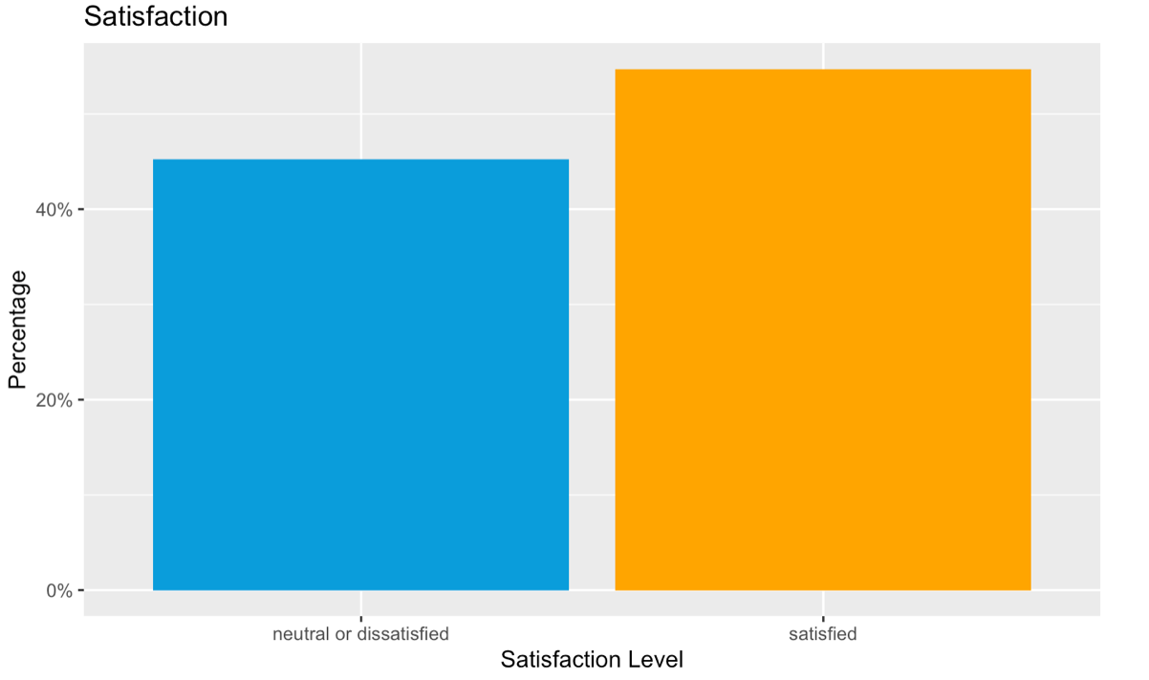
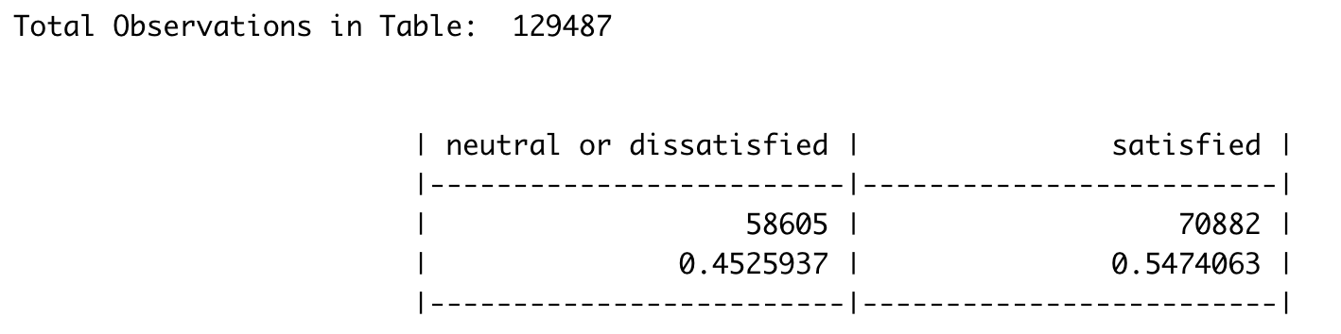
BIAS CHECK
54.74% of the population are satisfied with the U.S Airline service
45.26% of the customers are neutral or dissatisfied with the service
Hence, the distribution of satisfied customers
and dissatisfied customers are roughly the same.
Notes:
Before the analysis, we did a bias check for our dataset to avoid bias in our research. From the data table and histogram here, we can see the distribution of satisfied customers and neutral or dissatisfied population are roughly the same.
In order to solve the business problem and improve customer satisfaction, we are going to explore the dataset from two aspects.
First of all, we will discover the relationship between variables and reveal the variables that are highly correlated with satisfaction level.
Secondly, we will analyze the demographic characters of high satisfaction population and define them as our target market.

Slide 6
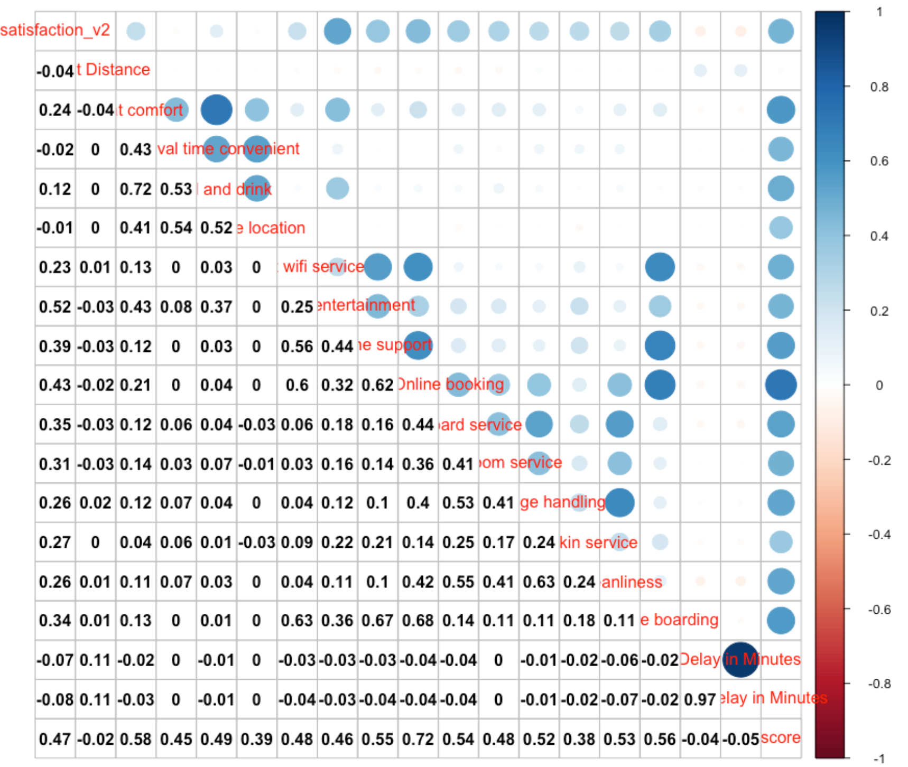
Correlation matrix
Top 3 attributes that are highly related to the satisfaction level:
Inflight Entertainment
Ease of Online Booking
Online Support
Notes:
To begin with, we created a correlation matrix between variables that appeared in the survey. Since the key variable that we focused on is the satisfaction level, we summarized the top three significant variables, which are inflight entertainment, ease of online booking, and online support.

Slide 7

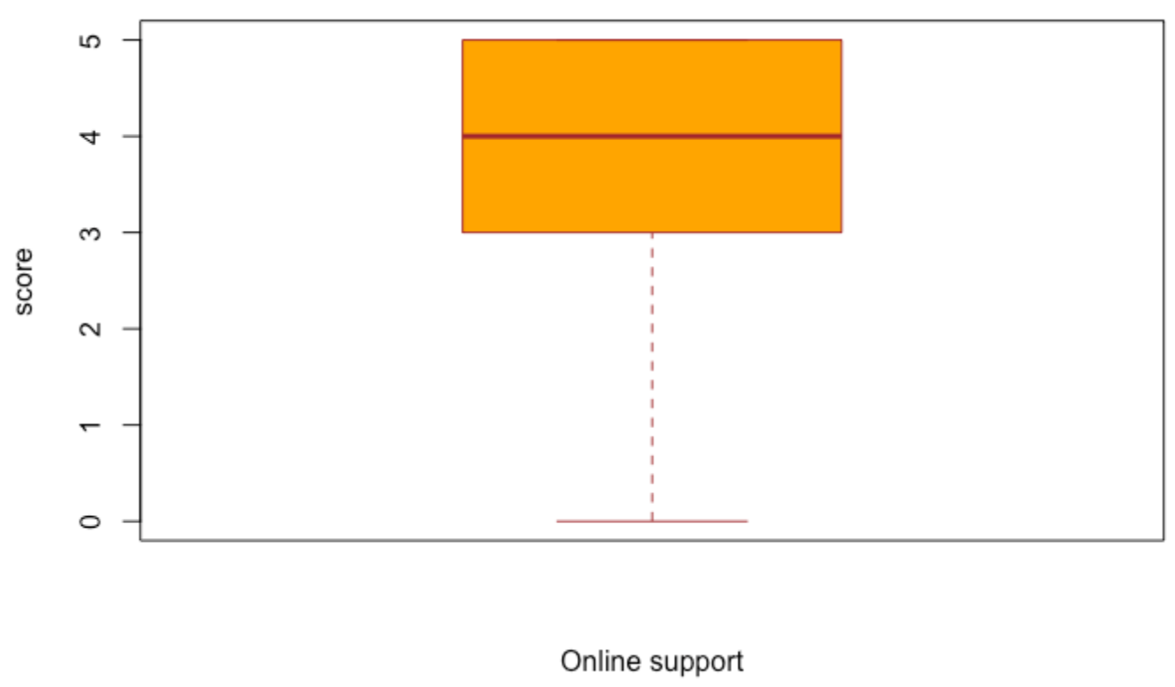
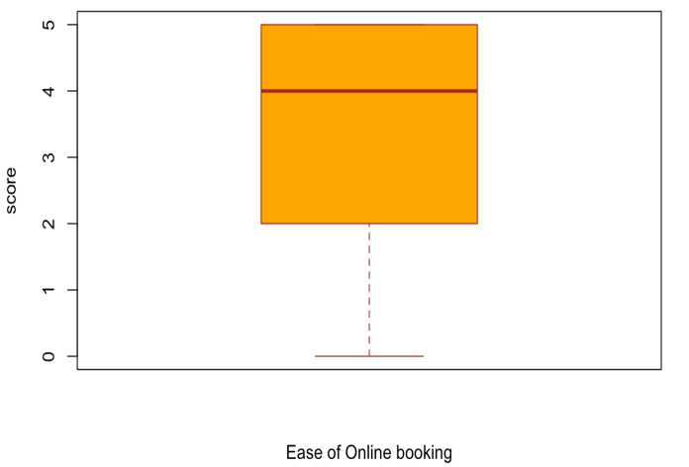
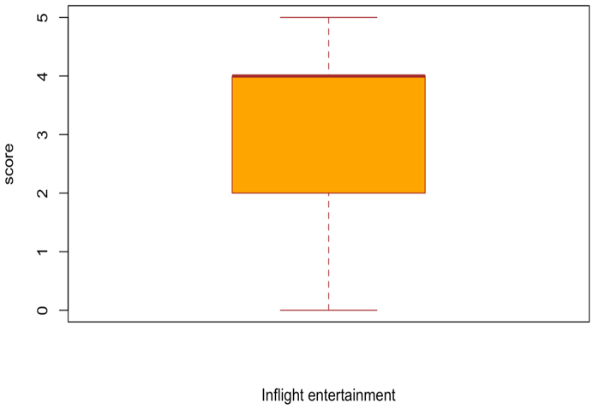
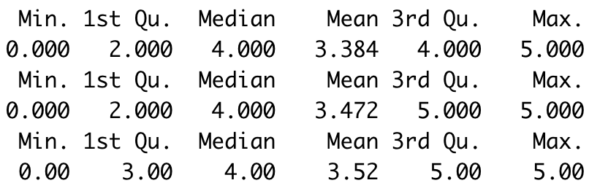

The mean score is around 3.3-3.5, so it is necessary for US Airline to improve the quality of service of these aspects in order to improve customer satisfaction.
Notes:
To take a closer look at these variables, we noticed that the mean score of them is all-around 3.3 -3.5. Thus, US Airline must ensure a higher quality of services in these aspects to reach a higher level of customer satisfaction.

Slide 8
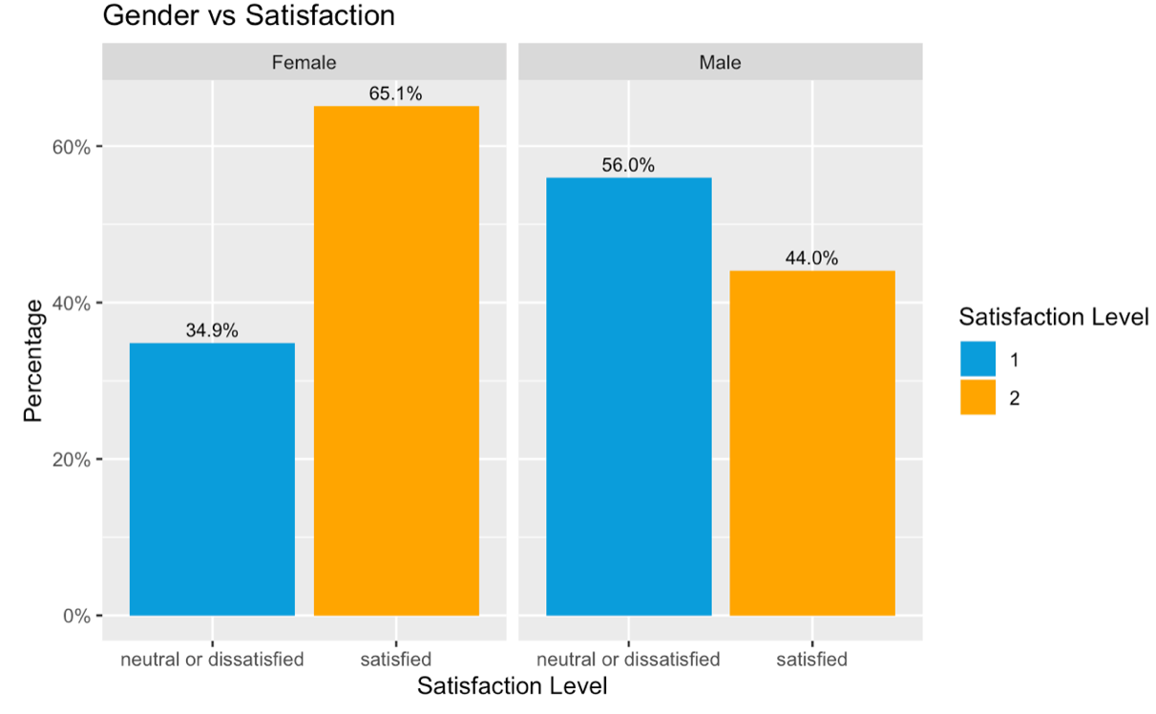
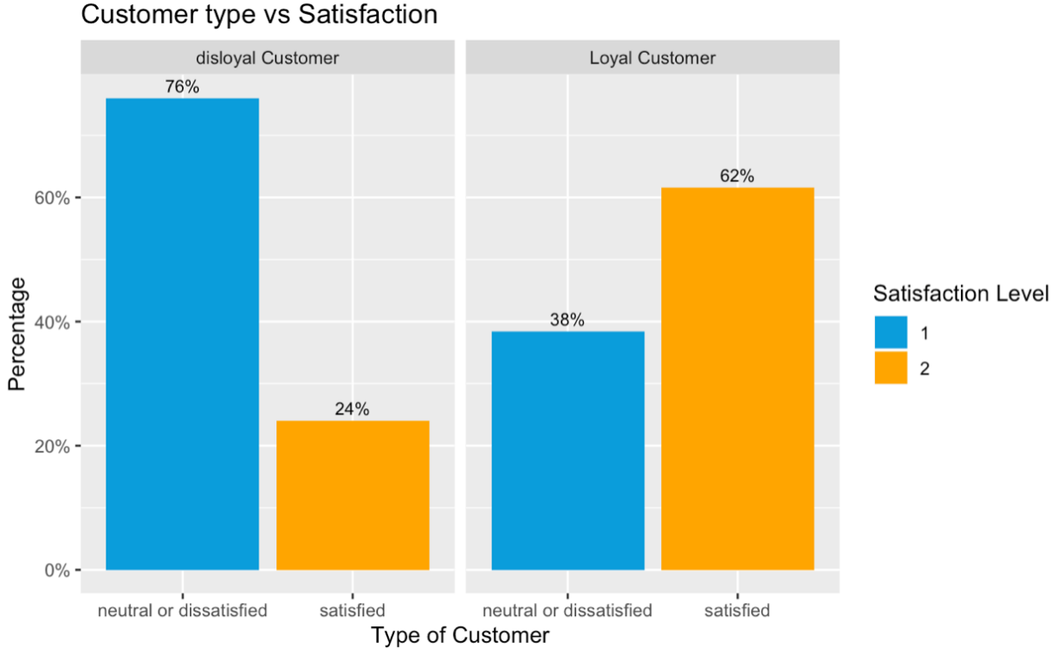
EXPLORATORY DATA ANALYSIS
Female passenger has 21.1% higher satisfaction level than male customer.
14 % more of loyal customers are
satisfied than the disloyal customer.
Notes:
Based on the personal information, we created histograms grouped by gender ,customer type, travel class, and travel type to compare their satisfaction level.

Slide 9
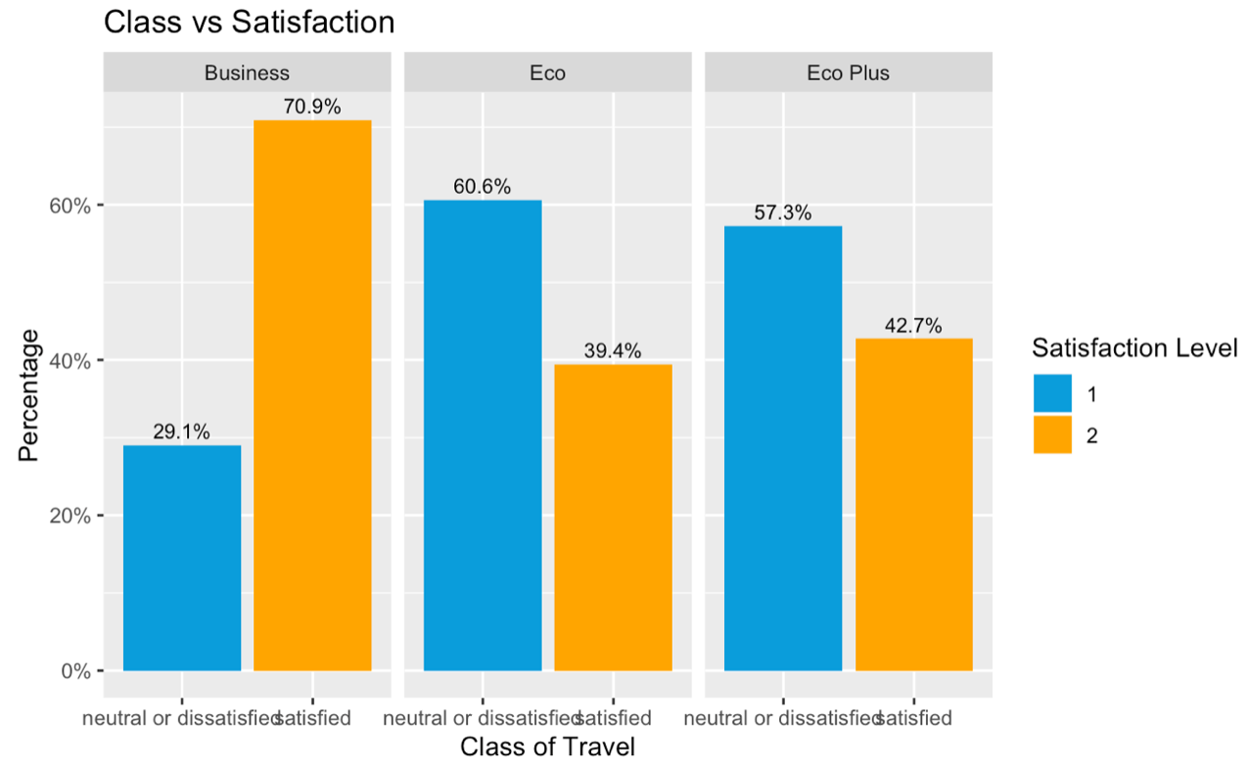
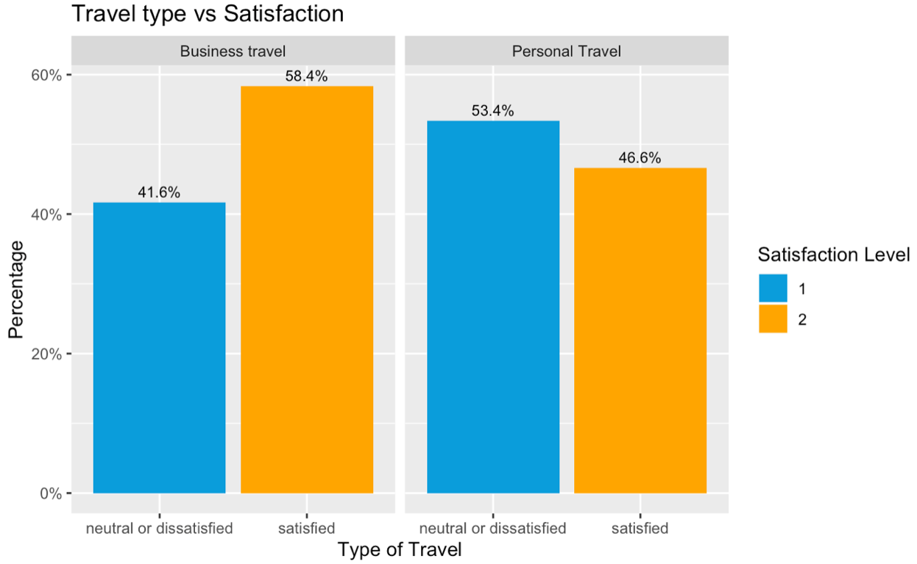
EXPLORATORY DATA ANALYSIS
the business class has the highest satisfaction
level and Eco and Eco Plus has approximately consistent satisfaction level.
Similarly, business travel customers have
higher satisfaction than personal travel customers
Notes:
In summary, we can conclude that female, business class, business travel, and loyal customers tend to be more satisfied with US Airline service.

Slide 10
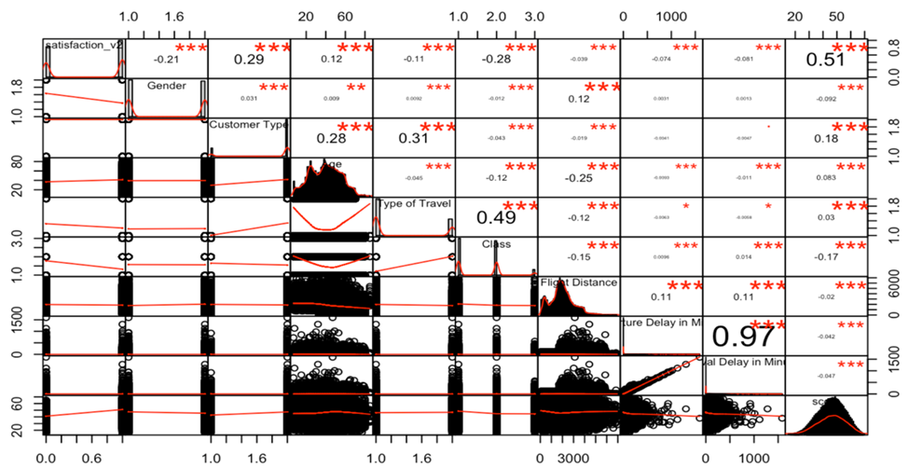
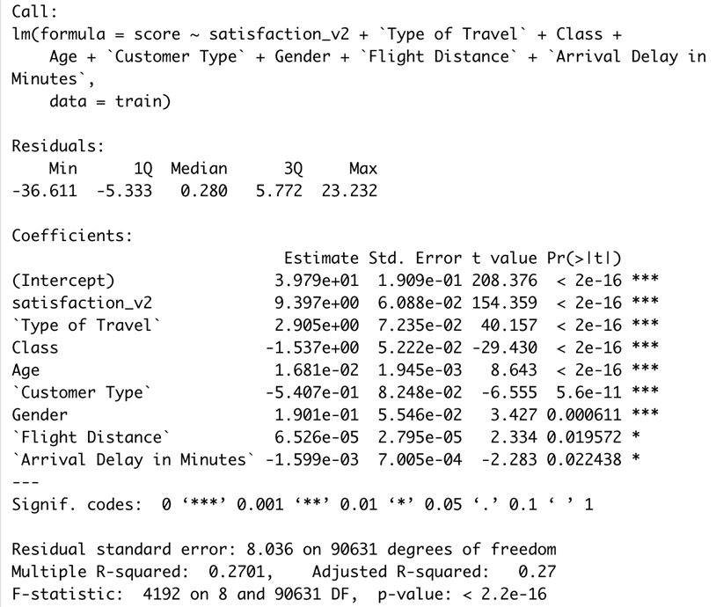
Linear regression model
Variable conversion: satisfaction_v2-> “score” factor -> numeric
Data split: 70%/30%
Check for overfitting-Correlation
R² | Adjusted R²
0.2701 | 0.27
Notes:
To perform a linear regression analysis, we created a new numeric attribute named score which is the sum of attributes related to the service satisfaction and converted all factorial attributes into numeric. After that, we divide 70% of our dataset into training dataset and the rest goes into testing dataset.
In addition, we plotted the correlation between all 10 variables. Based on the graph on the left side, we can see a strong correlation between “Departure Delay in Minutes” and “Arrival Delay in Minutes”. To avoid overfitting, we will drop one of them if both variables were selected for the final model.
After creating the null model and full model, we applied the Stepwise() selection to generate the final model.
Finally, from the summary of the final model, we can observe that the R-squared is equal to 0.2701 and the adjusted R² is equal to 0.27, which means that only 27 % of the data is described by our linear model.

Slide 11
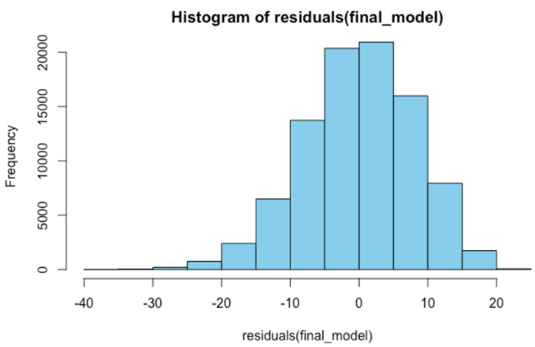
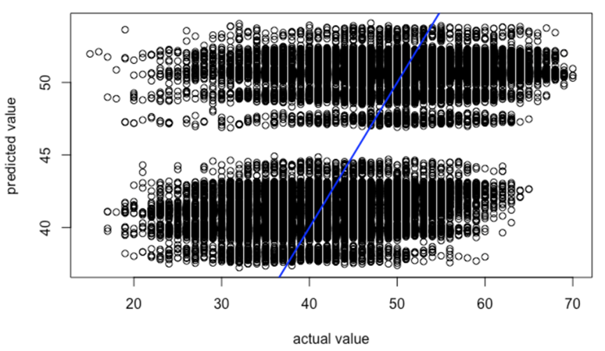
Linear regression model
R² | RMSE
0.2748838 | 8.043188
Notes:
Then we predicted the score with the test dataset and created a plot between the observed value and the predicted value showing on the left side. From the plot here, it matches with our conclusion that our variables are not highly linearly correlated.
To evaluate our linear regression model, we also calculated the R² and RMSE. The output indicates that the linear regression model is not suitable for our variables.
Lastly, from the histogram of residuals on the right side, we can see the residuals (the error terms) are normally distributed, so our data follows linear regression assumptions.

Slide 12
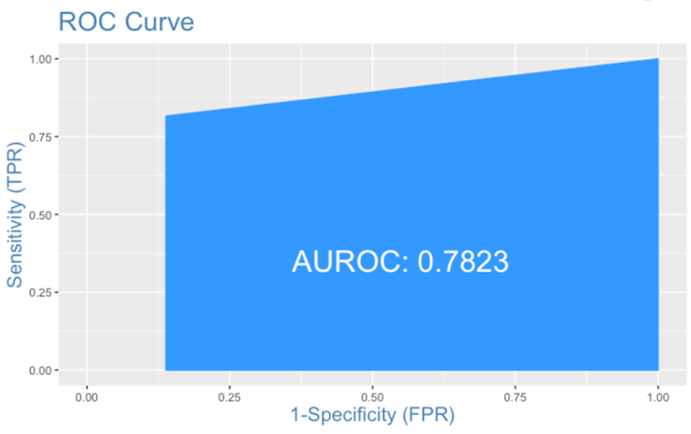
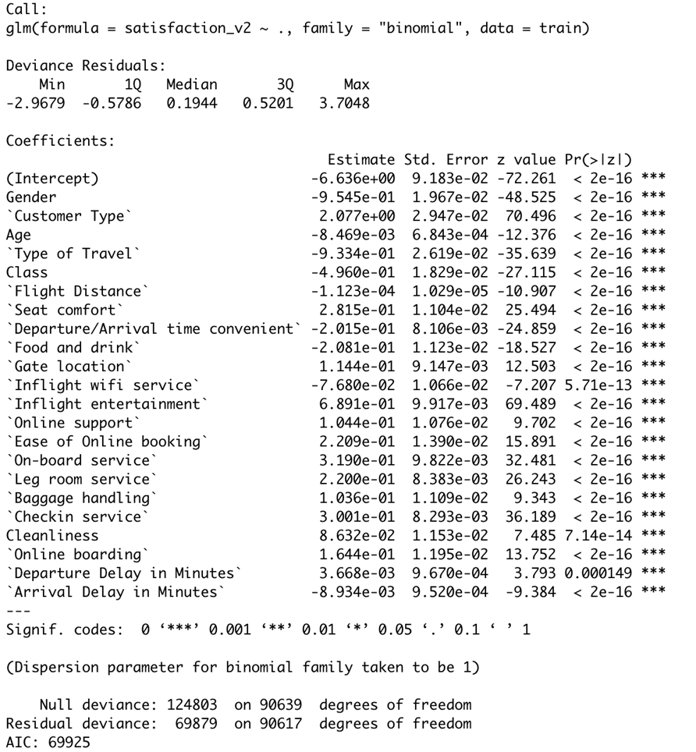
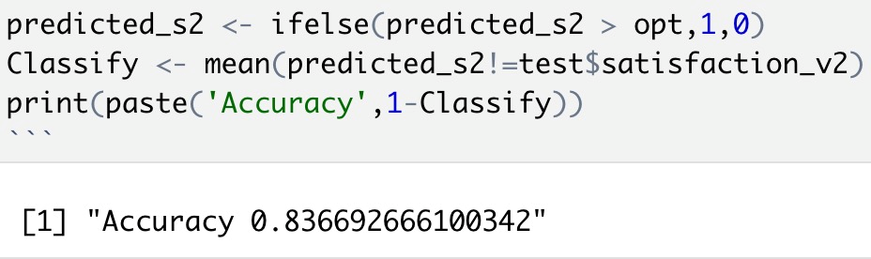
Logistic regression model
Variable conversion: satisfaction_v2-> 0 or 1
Accuracy | Misclassification | Sensitivity | Specificity
83.70% | 16.30% | 87.63% | 79.65%
Notes:
For the Logistic regression model, the predictor variable has to be binary. Hence, we transformed the “satisfaction_v2” into a binary variable, where “satisfied” is marked as “1” and the other is “0”.
After building the model, we made prediction with the test dataset and calculated the accuracy with the confusion matrix, which is equal to 83.7%.
Lastly, we plotted the ROC to trace the percentage of true positives accurately predicted by the given logit model. Since the ROC value equals to 0.7823, we can conclude the logistic model is moderately efficient.

Slide 13
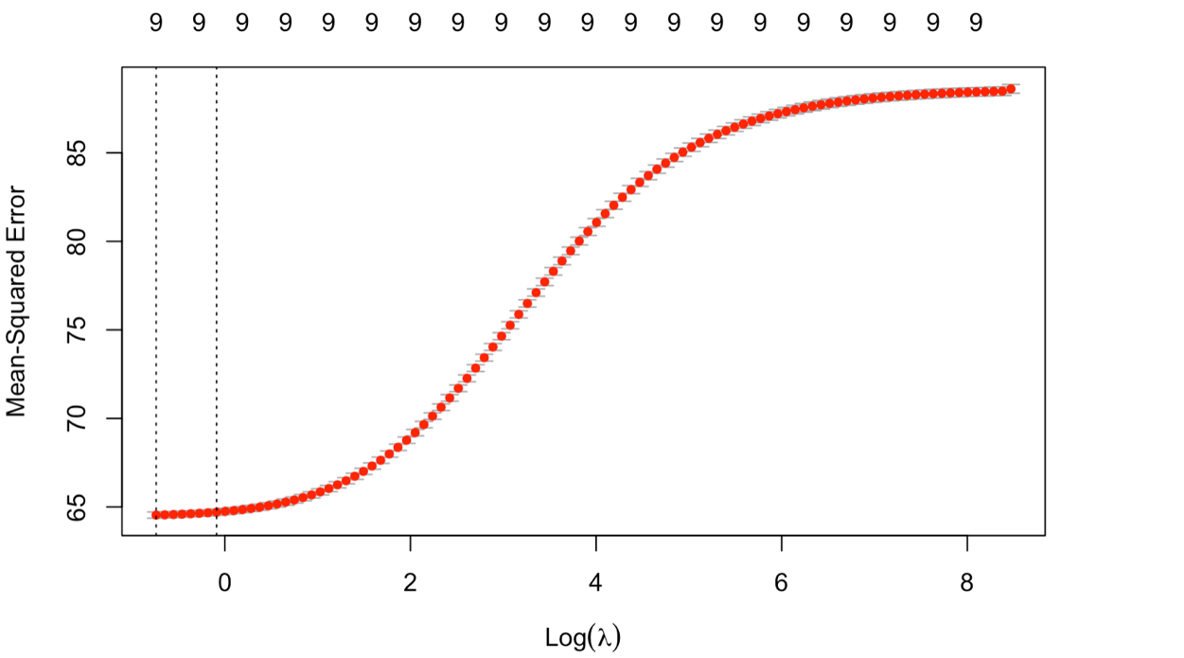
Ridge regression
Best Lambda
0.4771427
R² | RMSE
0.9708812 | 0.0308646
Notes:
In order to improve our models, we applied regularization with the ridge regression model . After setting of alpha =0, we created a ridge regression model and generated a plot between Log(λ) and mean squared error. From the plot here, we calculated the best lambda is equal to 0.477. With the best fitting parameter and lambda estimates from the training data, we made perdition on the test dataset and evaluate the performance. Based on the value of R2 and rmse, we can conclude that the ridge model is statistically suitable for our dataset

Slide 14
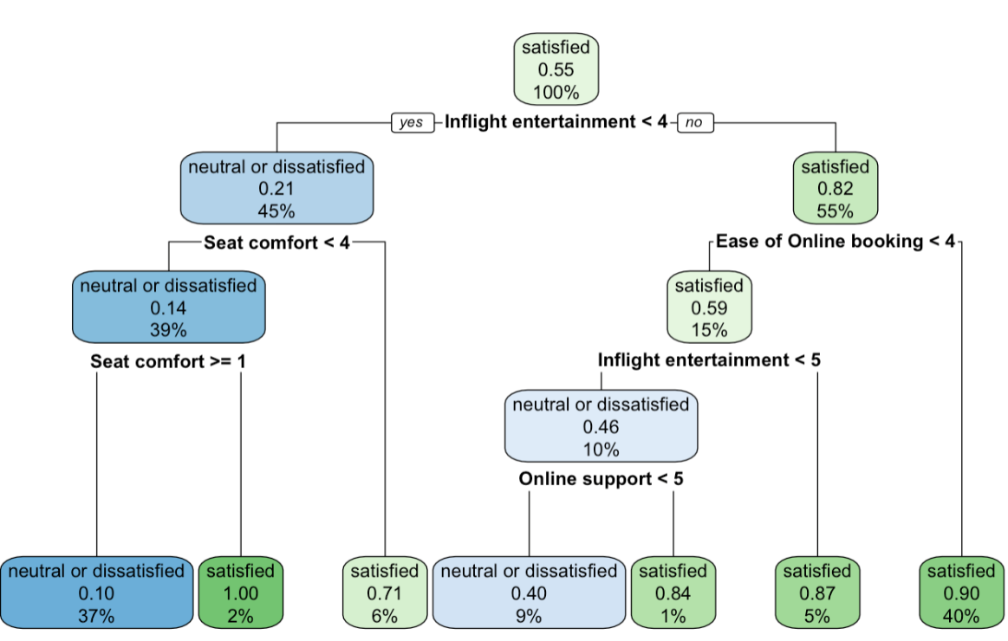
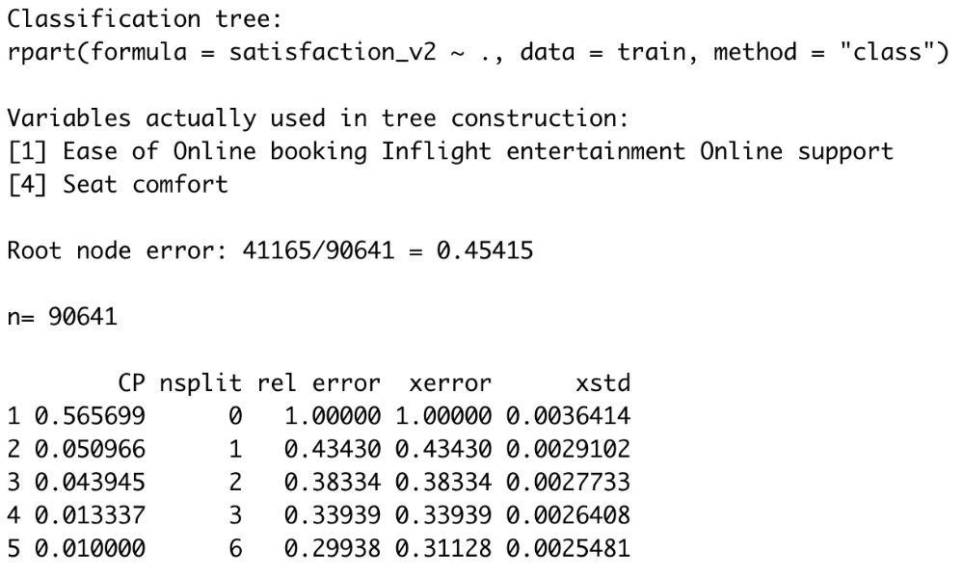
Decision tree model
Notes:
From the dt model here, we can see only 4 significant variables are used to build the tree and they are “Ease of Online booking”, “Inflight entertainment”, “Online support”, and “Seat comfort”.

Slide 15
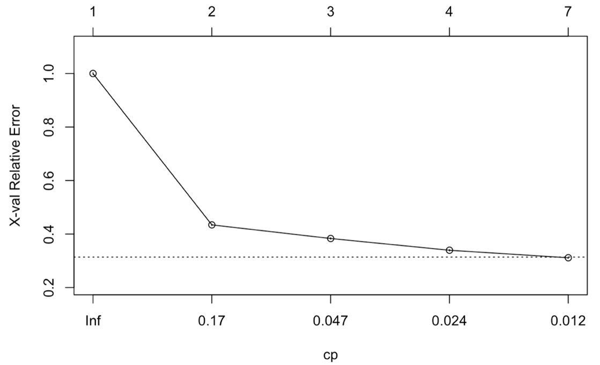
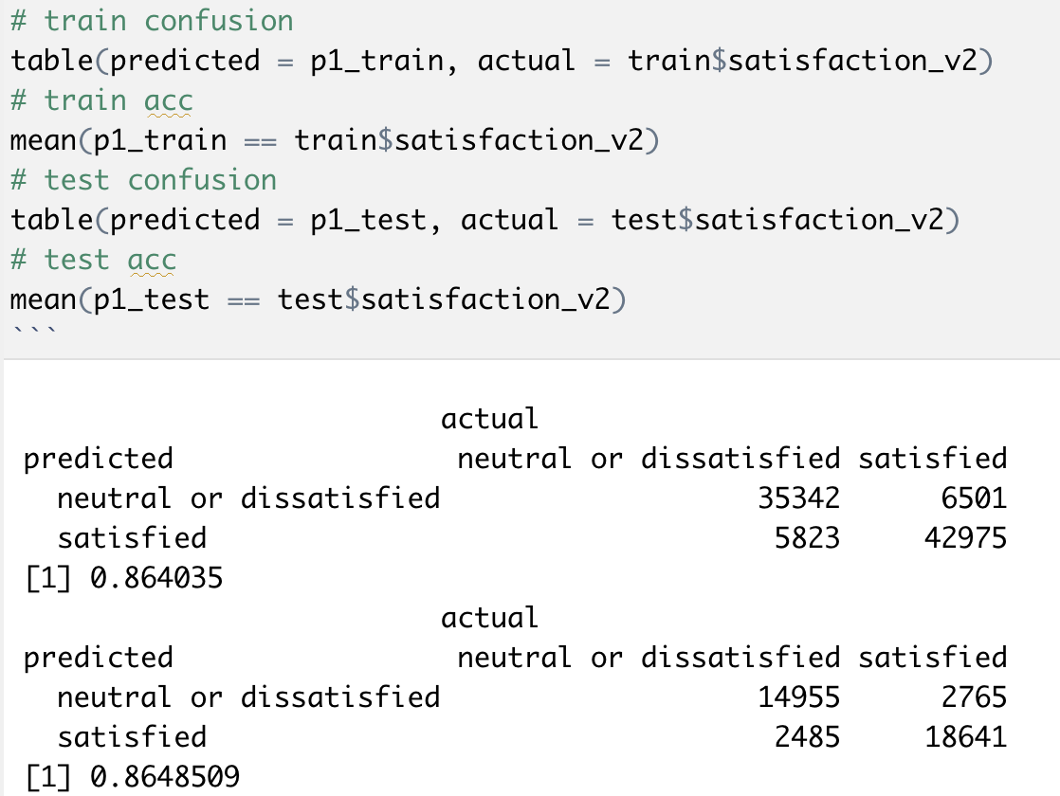
Decision tree model

Slide 16
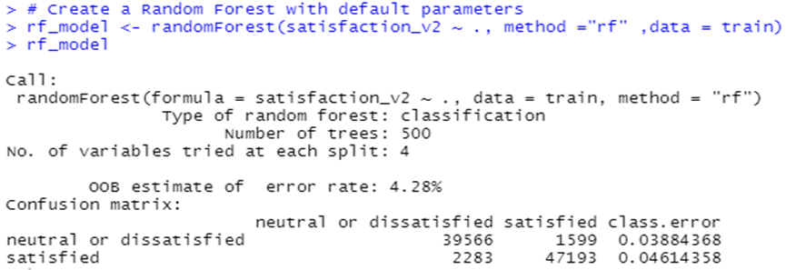
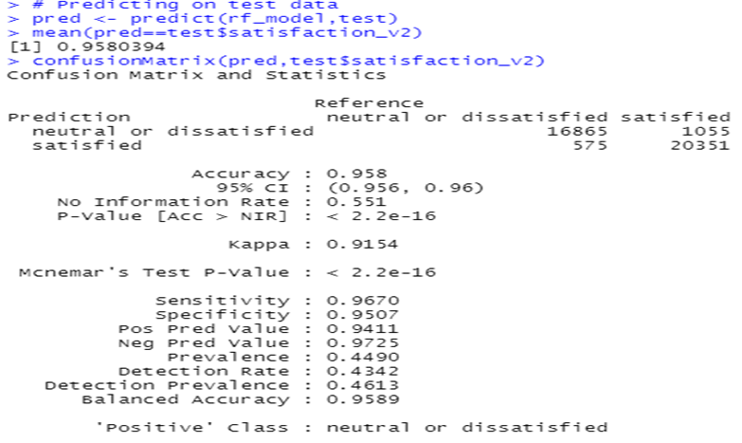
Random forest model
Number of trees N | Out of bag (OOB) error | Accuracy
500 | 4.28% | 95.8%
Notes:
Similarly to decision tree, Random forest modelling works by creating multiple decision trees and then combining the output generated by each of the decision tree to predict our outcome variable.
We look at two parameters: one is number of trees N and another is mtry as number of variables available for splitting at each tree node.
By default, N is 500 and mtry is 4. And the out of bag error is 4.28% and the accuracy we generated is 95.8%.

Slide 17
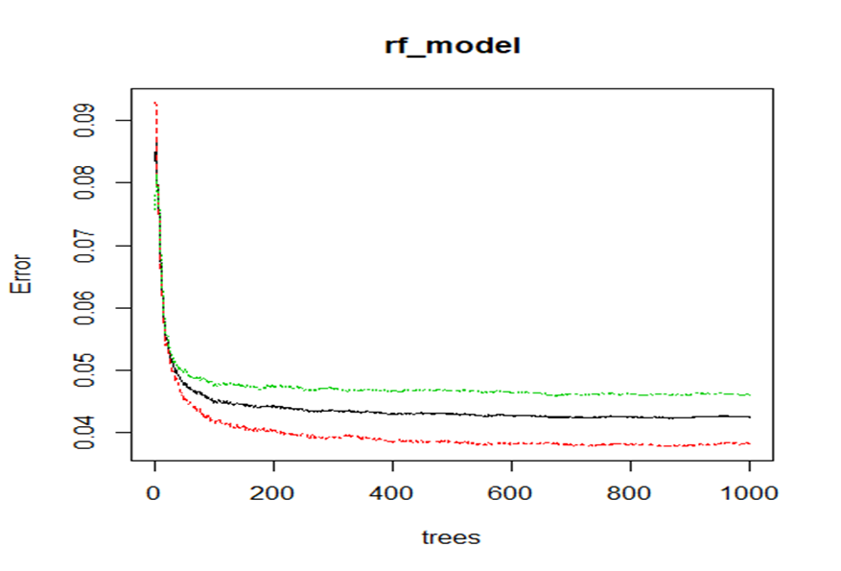
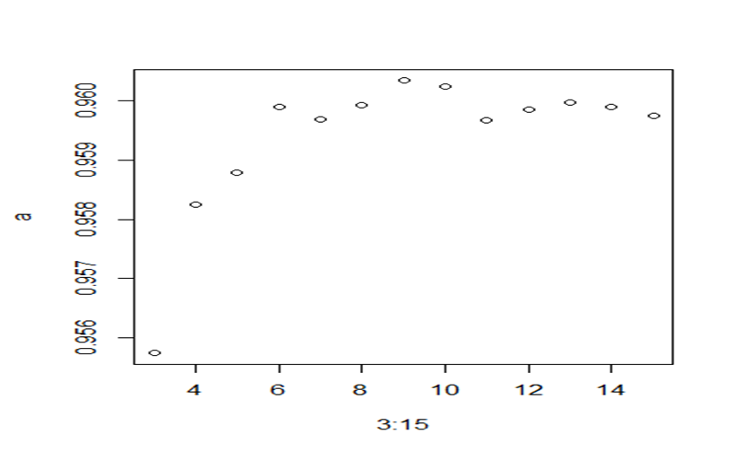
Random forest model Optimization
Optimal N | Optimal mtry
300 | 9
OOB error | Accuracy
4.09% | 96.01%
Notes:
To optimize our model, we plotted error rate in terms of number of trees and find out that the error rate tends to be stabilize as the number of trees gets after 300.
We then used tuning algorithm to find the best mtry in terms of optimizing the highest accuracy and we can observe from the right graph that when the mtry value equals to 9, it has the highest accuracy of 96%, but it seems not improving much compared to our default accuracy 95.8%.

Slide 18
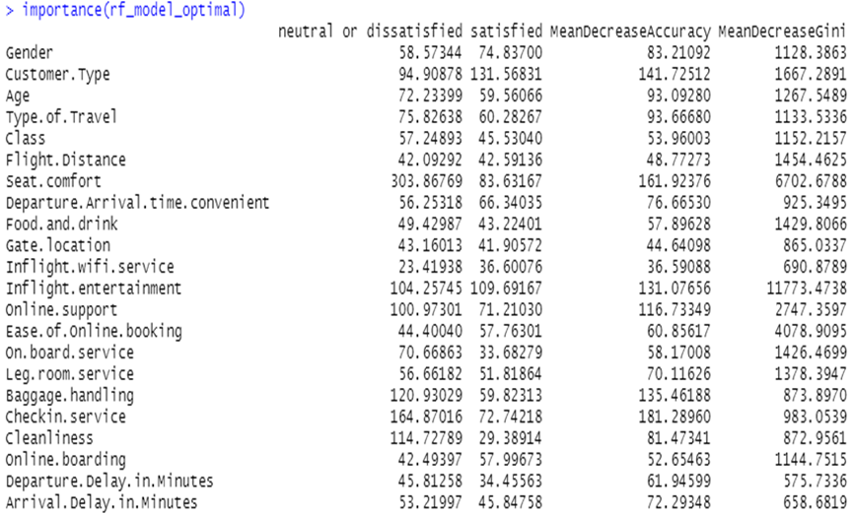
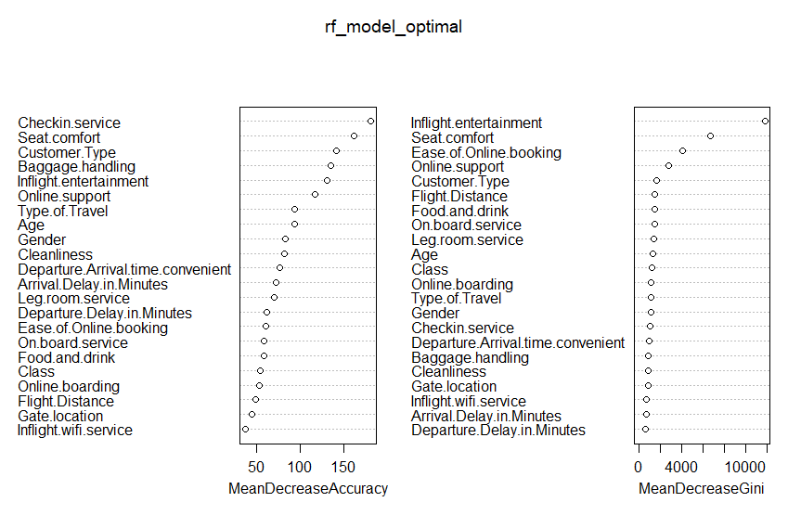
Important variables
Top 3 Important Variables: inflight entertainment, seat comfort, and ease of online booking
Notes:
This plot show the importance of each variable in the model by the accuracy and the Gini Index.
The two graphs show that Inflight.entertainment and seat comfort are most relevant to our model’s accuracy, followed by ease of online booking.

Slide 19
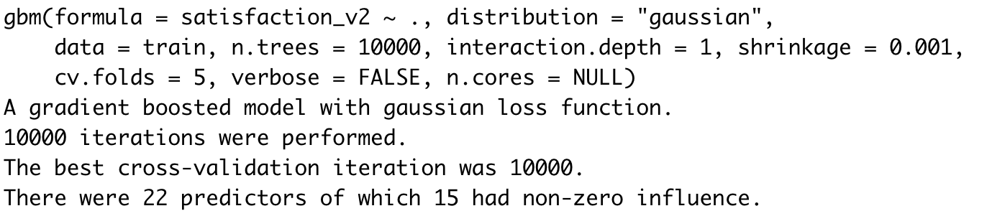
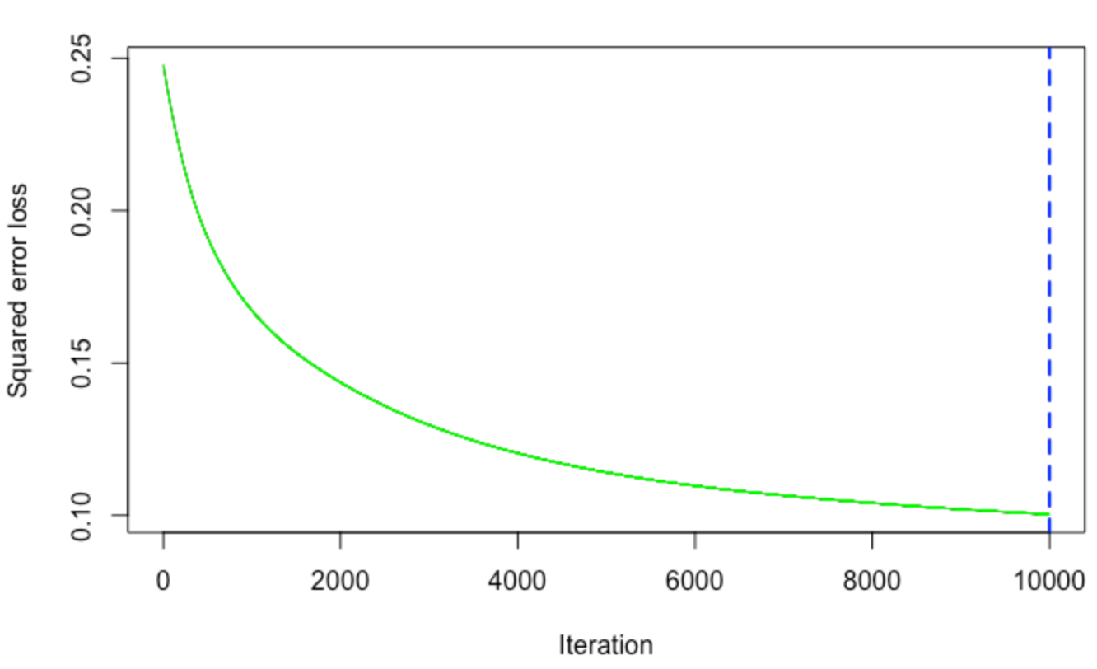
GRADIENT BOOSTING MACHINE (GBM) MODEL
First GBM Model(gbm_model)
10,000 iterations were performed, and the
best cross-validation iteration was 10,000
The validation error decreases as the optimum iteration move to 10,000
NUMBER OF TREES | RMSE
10,000 | 0.3167633
Notes:
With the same portion of training and test data, we created the first gbm model with 10000 trees and output shows the best cross-validation iteration was 10000. Since we have quite large dataset, we increased the number of trees to 15,000 and generated second gbm model

Slide 20
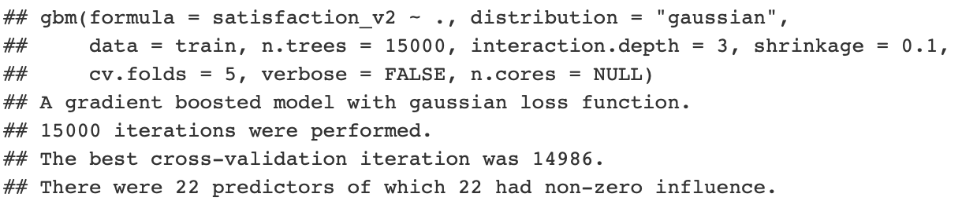
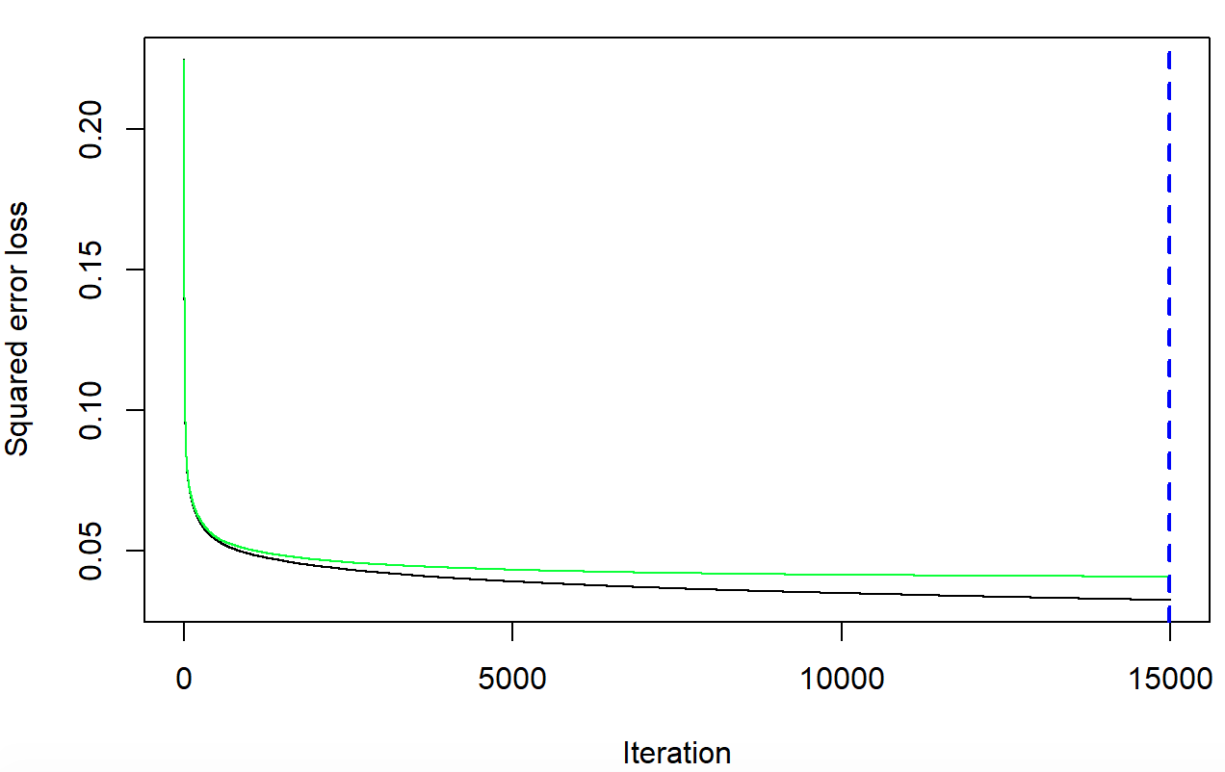
GBM MODEL
Second GBM Model(gbm_model2)
Best cross validation
iteration:14,986 trees
Both the training error and the validation error decreases as the number of iterations increased around 15,000
NUMBER OF TREES | RMSE
15,000 | 0.2019807

Slide 21
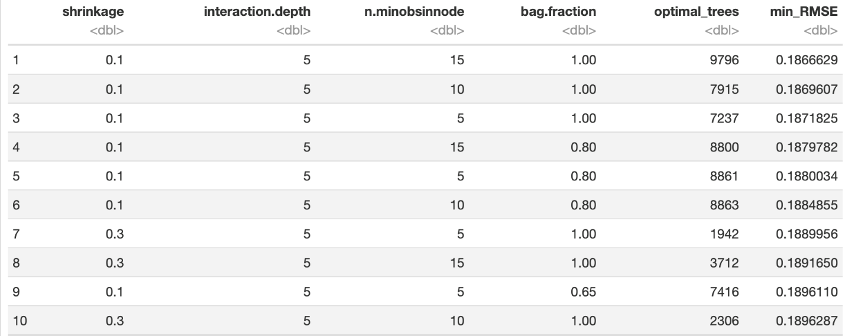
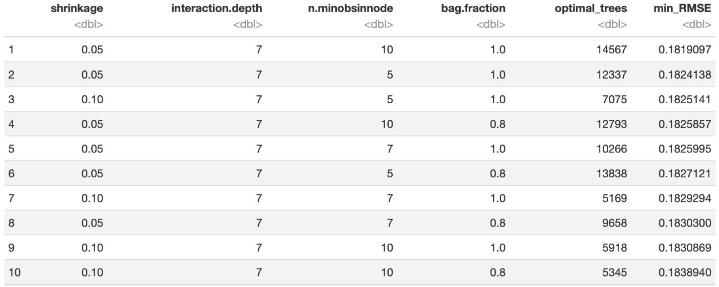
GBM MODEL
Step1: created hyperparameter grid
Step2: number of combinations :81
Step3: randomize data
Step4: grid search
Step 5: determine the parameters for the final model
Lower RMSE
Notes:
To optimize our gbm model, we first create hyperparameter grid and construct our grid of hyperparameter combinations. We’re going to search across 81 combination with varying learning rates and tree depth.

Slide 22
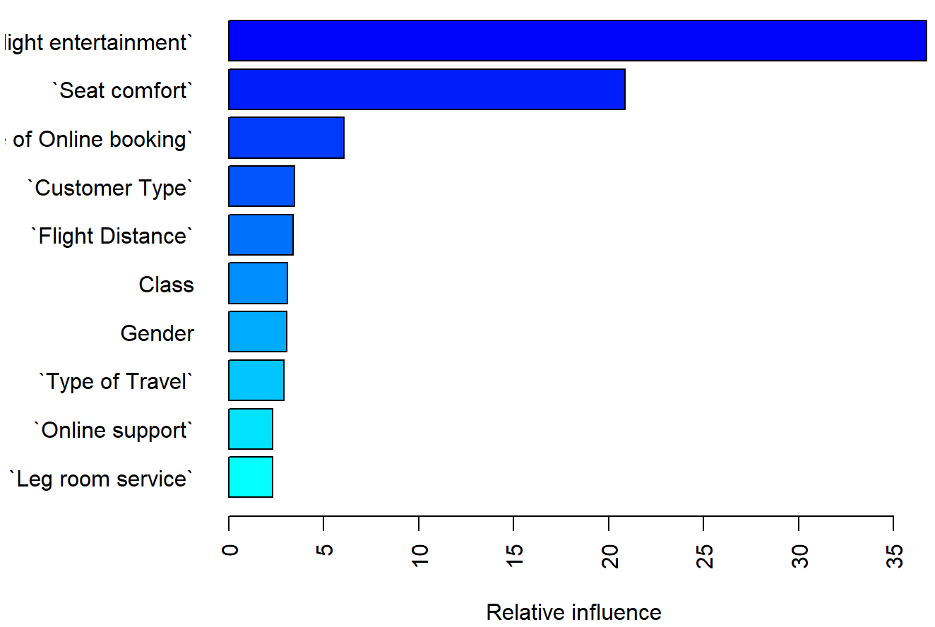
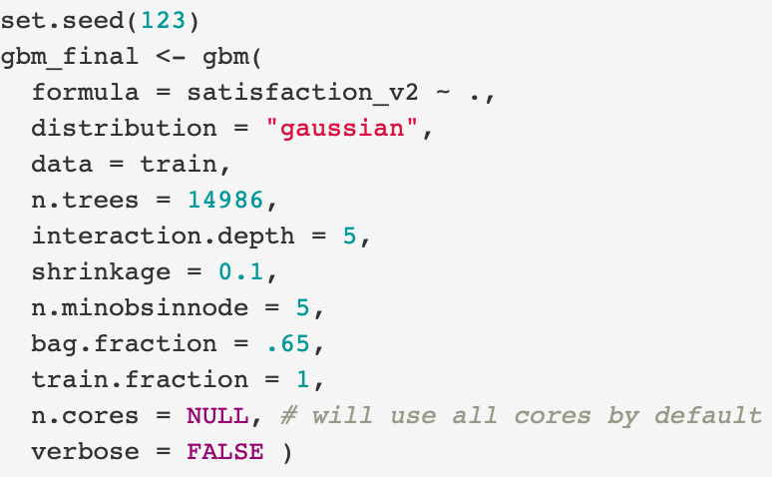
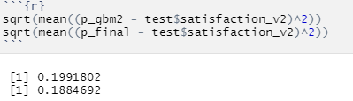
GBM MODEL
Final GBM Model
Variable Importance
Prediction & Accuracy
Top 3: Inflight entertainment, seat comfort, and ease
of online booking

Slide 23
Model COMPARISION
 | R² | RMSE | Running Time
Linear Regression Model | 0.27 | 8.04 | ~3mins
Ridge Regression Model | 0.97 | 0.03 | ~2mins
GBM Model | / | 0.19 | ~3 days
Accuracy:
Ridge Regression Model >
GBM Model >
Linear Regression Model
Accuracy:
Random Forest Model >
Decision Tree Model >
Logistic Regression Model
 | Accuracy | Misclassification | ROC | Running Time
Logistic Regression Model | 83.67% | 16.33% | 0.7823 | ~2 mins
DT Model | 86.40% | / | / | ~ 3mins
RF Model | 96.01% | / | / | ~ 8 hours
Running Time:
GBM Model > Random Forest Model > other models

Slide 24

Conclusion
Both Ridge Regression model and Random Forest Model is statistically more suitable for our dataset with an accuracy up to 95%+
Based on the exploratory analysis and predictive models, we can conclude that inflight entertainment, online service, and seat comfort level are attributes that significantly impact on customer satisfaction
Hence, US Airline must ensure higher quality service in those aspects to maintain loyal customers and attract more customers

Slide 25
references
D, J. (2018, June 10). Passenger Satisfaction. Retrieved July 12, 2020, from https://www.kaggle.com/johndddddd/customer-satisfaction?select=satisfaction.xlsx
Thank you for watching!

